Slide 1

SOKOINE UNIVERSITY OF AGRICULTURE
Department of Informatics and Information Technology (DIIT)
BIT 111: MICROCOMPUTERS AND APPLICATIONS
TOPIC 1: INTRODUCTION TO COMPUTERS
Official Undergraduate Lecture Slide Deck (Academic Year 2026/2027)
• Curriculum Coverage: Generations (1.1) | History & Pioneers (1.2) | Classifications (1.3)
• Course Instructor: Madam Bertha Msuliche Lebalwa (MSc)
• Assessment Structure: 2 Assignments (5%), 2 Tests (15%), Practical Report (10%), Practical Test (30%), UE (40%)*
*Assessment weightings are subject to adjustment by the course instructor.
BIT 111: Microcomputers and Applications | Instructor: Madam Bertha Msuliche Lebalwa (MSc) - SUA Morogoro
Slide 1 of 42

Slide 2
BIT 111: MICROCOMPUTERS AND APPLICATIONS | SOKOINE UNIVERSITY OF AGRICULTURE
Topic 1: Lecture Outline & Learning Roadmap
Foundational Computing Principles (Curriculum Coverage: 1.1, 1.2, 1.3)
• Section 1.1: Evolution & The Five Computer Generations
- Active switching electronics: Vacuum tubes to ULSI & Quantum gates
- Architectural shifts, primary memory evolution & programming paradigms
• Section 1.2: History of Computing & Visionary Pioneers
- Mechanical precursors: Abacus, Pascaline, Leibniz Reckoner, Jacquard
- Babbage's Difference/Analytical Engine & Ada Lovelace's algorithms
- Turing's computability, Hollerith's punch cards, and the Microprocessor explosion
• Section 1.3: Multi-Dimensional Computer Classifications
- Physical size & processing power: Supercomputers, Mainframes, Micros, Embedded
- Signal technology: Analog, Digital, and Hybrid paradigms
- Operational purpose & Network roles: General vs Dedicated; Clients vs Servers
• Conceptual factors that influence computer performance
PEDAGOGICAL GOAL
Understand the historical development, main parts, and everyday uses of computers, establishing a foundation for further study.
BIT 111: Microcomputers and Applications | Instructor: Madam Bertha Msuliche Lebalwa (MSc) - SUA Morogoro
Slide 2 of 42

Slide 3
BIT 111: MICROCOMPUTERS AND APPLICATIONS | SOKOINE UNIVERSITY OF AGRICULTURE
Topic 1: Intended Learning Outcomes (ILOs)
Core Competencies for SUA Undergraduate Students
• Define data, information, and the Information Processing Cycle (IPOS).
• Contrast the physical components, speed, memory, and programming of all 5 computer generations.
• Explain John von Neumann's stored-program architecture and the 'Von Neumann Bottleneck'.
• Identify seminal computing pioneers and their engineering contributions to modern IT.
• Systematically classify any computer by size, signal technology, purpose, and network role.
• Describe, without calculations, how processor design, memory, and software affect performance.
• Formulate appropriate microcomputer infrastructure choices for agricultural and enterprise applications.
BIT 111: Microcomputers and Applications | Instructor: Madam Bertha Msuliche Lebalwa (MSc) - SUA Morogoro
Slide 3 of 42

Slide 4
BIT 111: MICROCOMPUTERS AND APPLICATIONS | SOKOINE UNIVERSITY OF AGRICULTURE
Fundamental Concepts: Data vs Information
The Raw Substrate versus The Contextualized Output
• Data: Raw, unorganized, uninterpreted facts, symbols, or observations without inherent meaning.
- Examples: `23.4`, `1014`, `12/04/2026`, `MWZ-042`
• Information: Data that has been processed, structured, contextualized, and organized to be meaningful.
- Example: 'Soil moisture at Mazimbu Block C dropped to 23.4% on 12/04/2026, triggering automated drip irrigation.'
• Knowledge: Applied information combined with experience, rules, and actionable insight.
• Metadata: 'Data about data' that defines properties, data types, timestamps, and provenance.
AGRICULTURAL CONTEXT
In SUA research trials, raw weather sensor logs are useless until processed into degree-day heat metrics to predict crop maturity.
BIT 111: Microcomputers and Applications | Instructor: Madam Bertha Msuliche Lebalwa (MSc) - SUA Morogoro
Slide 4 of 42

Slide 5
BIT 111: MICROCOMPUTERS AND APPLICATIONS | SOKOINE UNIVERSITY OF AGRICULTURE
The Information Processing Cycle (IPOS)
The Universal Operational Cycle of Electronic Computers
• Input: Acceptance of external data and instructions into binary form via input transducers (keyboards, mice, optical sensors, ADC).
• Processing: Arithmetic manipulation and logical evaluation executed by the CPU according to stored software instructions.
• Output: Transformation of internal binary results into human-comprehensible or machine-actuatable forms (displays, printers, solenoids).
• Storage: Non-volatile persistence of programs and data on secondary storage media (SSDs, HDDs, flash memory) for future retrieval.
• Communication (Modern 5th Element): Transmission of data and telemetry across local buses and network interfaces (Ethernet, Wi-Fi, LoRaWAN).
BIT 111: Microcomputers and Applications | Instructor: Madam Bertha Msuliche Lebalwa (MSc) - SUA Morogoro
Slide 5 of 42

Slide 6
BIT 111: MICROCOMPUTERS AND APPLICATIONS | SOKOINE UNIVERSITY OF AGRICULTURE
First Generation Computers (1940 – 1956)
The Thermionic Valve Era: Massive Scale, Heat, and Hardwiring
• Active Electronics: Vacuum Tubes (Thermionic Valves) acting as binary switches and amplifiers.
• Internal Memory: Mercury Delay Lines, Williams-Kilburn Tubes, and early Magnetic Drums.
• Input / Output Media: Punched cards (80-column Hollerith format) and paper tape.
• Programming Paradigm: Raw Machine Language (binary 0s and 1s) and manual plugboard wiring.
• Operational Characteristics: Enormous electrical power consumption (150+ kW), severe heat generation, and frequent tube blowouts (MTBF < 2 hours).
• Landmark Systems: ENIAC (1945), EDVAC (1949), UNIVAC I (1951 - first commercial computer).
BIT 111: Microcomputers and Applications | Instructor: Madam Bertha Msuliche Lebalwa (MSc) - SUA Morogoro
Slide 6 of 42

Slide 7
BIT 111: MICROCOMPUTERS AND APPLICATIONS | SOKOINE UNIVERSITY OF AGRICULTURE
Second Generation Computers (1956 – 1963)
The Solid-State Revolution: Discrete Transistors & Ferrite Core
• Active Electronics: Discrete Bipolar Junction Transistors (invented at Bell Labs in 1947).
• Transistor Advantages: 1/1000th the size of tubes, fraction of the power, instant-on, no fragile filament to burn out.
• Internal Memory: Magnetic Ferrite Core Memory (coincident-current toroidal rings, non-volatile).
• Secondary Storage: Magnetic tape drives and early commercial magnetic disk drives (IBM RAMAC 305, 1956).
• Software Evolution: Emergence of Assembly Language and early High-Level Languages (FORTRAN for science, COBOL for business).
• Landmark Systems: IBM 7090, IBM 1401, DEC PDP-1 (precursor to minicomputers).
BIT 111: Microcomputers and Applications | Instructor: Madam Bertha Msuliche Lebalwa (MSc) - SUA Morogoro
Slide 7 of 42

Slide 8
BIT 111: MICROCOMPUTERS AND APPLICATIONS | SOKOINE UNIVERSITY OF AGRICULTURE
Third Generation Computers (1964 – 1971)
The Monolithic Integrated Circuit (IC) & Time-Sharing
• Active Electronics: Small-Scale Integration (SSI: < 100 transistors) and Medium-Scale Integration (MSI: 100–1,000 transistors) on silicon planar chips.
• Circuit Innovation: Invented independently by Jack Kilby (Texas Instruments) and Robert Noyce (Fairchild Semiconductor).
• Operating System Revolution: Multi-programming and Time-Sharing Operating Systems (OS/360, MULTICS, early UNIX).
• Interactive Terminals: Video display terminals (VDTs) replaced punched cards, allowing real-time interactive debugging.
• Standardization: Introduction of the 8-bit byte and ASCII character encoding standard.
• Landmark Systems: IBM System/360 family (upward-compatible architecture), DEC PDP-8 (first mass-market minicomputer).
BIT 111: Microcomputers and Applications | Instructor: Madam Bertha Msuliche Lebalwa (MSc) - SUA Morogoro
Slide 8 of 42

Slide 9
BIT 111: MICROCOMPUTERS AND APPLICATIONS | SOKOINE UNIVERSITY OF AGRICULTURE
Fourth Generation Computers (1971 – Present)
Microprocessors, LSI/VLSI, and the Personal Computer Revolution
• Active Electronics: Large-Scale (LSI: 10<sup>3</sup>–10<sup>4</sup>) and Very Large-Scale Integration (VLSI: 10<sup>4</sup>–10<sup>7</sup> transistors per die).
• The Microprocessor: Complete CPU on a single silicon chip (Intel 4004 in 1971; Intel 8080/8086).
• Primary Memory: Semiconductor DRAM (Dynamic RAM) displacing magnetic core.
• Personal Computing Emergence: Altair 8800 (1975), Apple II (1977), IBM 5150 PC (1981).
• Graphical User Interfaces (GUI): Desktop metaphor, WIMP (Windows, Icons, Menus, Pointer) popularized by Apple Macintosh (1984) and Microsoft Windows.
• Secondary Storage: 5.25" and 3.5" floppy disks, high-capacity HDDs, optical CD-ROMs, and early flash memory.
BIT 111: Microcomputers and Applications | Instructor: Madam Bertha Msuliche Lebalwa (MSc) - SUA Morogoro
Slide 9 of 42

Slide 10
BIT 111: MICROCOMPUTERS AND APPLICATIONS | SOKOINE UNIVERSITY OF AGRICULTURE
Fifth Generation Computers (Present & Future)
Ultra-Large Scale Integration, Multi-Core, AI & Quantum Systems
• Active Electronics: Ultra Large-Scale Integration (ULSI) with tens of billions of transistors (3nm / 2nm lithography).
• Architectural Paradigms: Massively parallel computing, heterogeneous computing (CPU + GPU + NPU / TPU).
• Artificial Intelligence & Deep Learning: Neural network inference accelerators integrated directly on silicon dies.
• Natural Interaction: Natural language processing, computer vision, voice recognition, adaptive bio-sensing.
• Distributed Cloud Computing: Elastic serverless architectures and edge-computing micro-nodes.
• Frontier Computing: Quantum computers (qubits, superposition, entanglement) solving cryptanalytic and molecular simulations.
BIT 111: Microcomputers and Applications | Instructor: Madam Bertha Msuliche Lebalwa (MSc) - SUA Morogoro
Slide 10 of 42

Slide 11
BIT 111: MICROCOMPUTERS AND APPLICATIONS | SOKOINE UNIVERSITY OF AGRICULTURE
Comparative Matrix: The Five Computer Generations
Generation | Active Device | Primary Memory | Programming Level | Relative Capability | Key Landmark
1st (1940-56) | Vacuum Tubes | Mercury Delay / Drums | Machine Language | Limited; very large systems | ENIAC, UNIVAC I
2nd (1956-63) | Transistors | Magnetic Core | Assembly / FORTRAN | Smaller and more reliable | IBM 7090, PDP-1
3rd (1964-71) | Integrated Circuits (SSI/MSI) | Magnetic Core / Semis | High-Level (COBOL, C) | More compact and versatile | IBM System/360
4th (1971-Pres) | VLSI Microprocessor | Semiconductor DRAM | 4GL, OOP, Web, Scripting | Personal and portable systems | IBM PC, Apple Mac
5th (Present+) | ULSI / Multi-Core / NPUs | 3D NAND / HBM / Quantum | AI, Python, Declarative | Connected, specialized systems | Multi-core, TPU, Rigetti
BIT 111: Microcomputers and Applications | Instructor: Madam Bertha Msuliche Lebalwa (MSc) - SUA Morogoro
Slide 11 of 42

Slide 12
BIT 111: MICROCOMPUTERS AND APPLICATIONS | SOKOINE UNIVERSITY OF AGRICULTURE
The Stored-Program Concept & Von Neumann Model
First Draft of a Report on the EDVAC (John von Neumann, 1945)
• Core Innovation: Both program instructions and operative data reside together in the same shared, addressable read-write memory space.
• Eliminates Hardwiring: Changing a computer program no longer requires physical rewiring or resetting patch cords.
• Five Architectural Subsystems:
1. Arithmetic Logic Unit (ALU): Executes arithmetic operations (+, -, *, /) and logical tests (AND, OR, NOT).
2. Control Unit (CU): Fetches, decodes, and orchestrates the micro-operations of each instruction.
3. Memory Subsystem: Linear array of addressable storage cells holding instructions and operands.
4. Input Subsystem: Channels accepting external signals into internal binary registers.
5. Output Subsystem: Channels presenting internal results to external devices.
BIT 111: Microcomputers and Applications | Instructor: Madam Bertha Msuliche Lebalwa (MSc) - SUA Morogoro
Slide 12 of 42

Slide 13
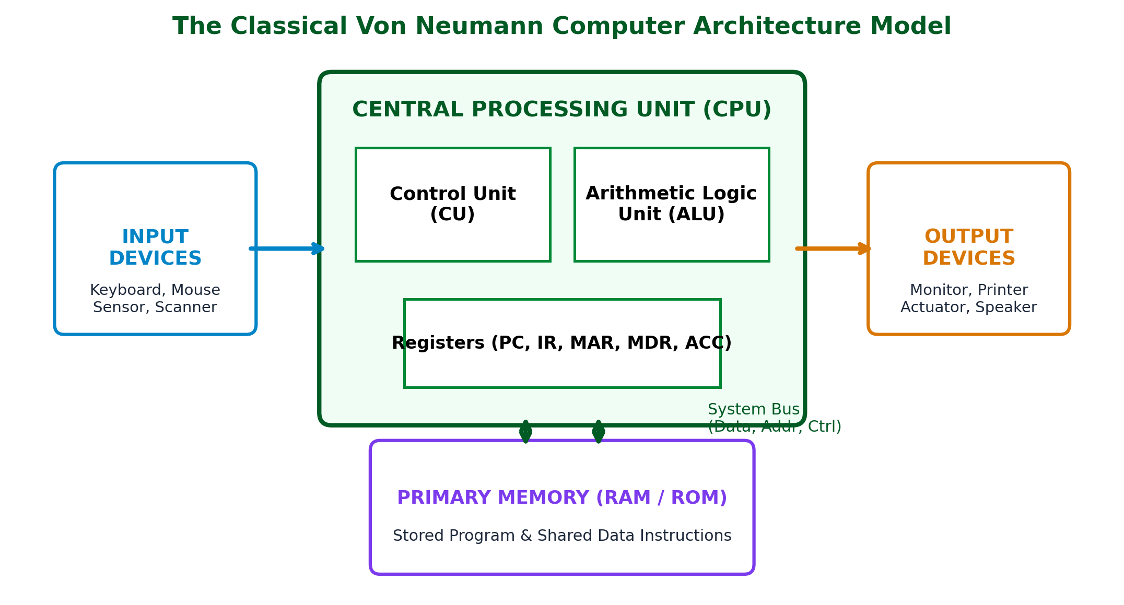
BIT 111: MICROCOMPUTERS AND APPLICATIONS | SOKOINE UNIVERSITY OF AGRICULTURE
Von Neumann Architecture & Shared Bus Pipeline
ARCHITECTURAL ANALYSIS & PRINCIPLES
• Unified Memory: Single physical bus path for instruction fetching and data reading/writing.
• The Von Neumann Bottleneck: CPU processing speed far outpaces memory bus bandwidth; CPU is frequently stalled waiting for memory operands.
• Modern Mitigations: Multi-level SRAM cache hierarchies (L1, L2, L3), instruction pre-fetching, branch prediction, and pipelining.
• Harvard Architecture Contrast: Implements physically separate buses for instructions and data (common in DSPs and ARM Cortex microcontrollers).
Figure: The classical Von Neumann model illustrating ALU, Control Unit, Registers, and System Bus interface.
BIT 111: Microcomputers and Applications | Instructor: Madam Bertha Msuliche Lebalwa (MSc) - SUA Morogoro
Slide 13 of 42

Slide 14
BIT 111: MICROCOMPUTERS AND APPLICATIONS | SOKOINE UNIVERSITY OF AGRICULTURE
Early History: Mechanical Aids to Automated Looms
From Manual Bead Computation to Programmable Cards
• The Abacus (c. 2500 BCE): First mechanical aid for positional arithmetic.
• Napier's Bones (1617, John Napier): Logarithmic calculation rods enabling rapid multiplication.
• The Slide Rule (1622, William Oughtred): Analog calculating device dominant until electronic pocket calculators (1970s).
• The Pascaline (1642, Blaise Pascal): First gear-driven mechanical calculating machine (addition and subtraction).
• Leibniz Stepped Reckoner (1673, Gottfried Wilhelm Leibniz): Stepped gear mechanism capable of direct multiplication and division; formulated binary arithmetic.
• Jacquard Loom (1804, Joseph Marie Jacquard): Used punched cards to automate complex textile weaving patterns — first programmable automation device.
BIT 111: Microcomputers and Applications | Instructor: Madam Bertha Msuliche Lebalwa (MSc) - SUA Morogoro
Slide 14 of 42

Slide 15
BIT 111: MICROCOMPUTERS AND APPLICATIONS | SOKOINE UNIVERSITY OF AGRICULTURE
Pioneers: Charles Babbage & Augusta Ada Lovelace
The Grandfathers and Grandmothers of Universal Computation
• Charles Babbage (1791–1871): 'Father of Computing'.
- Difference Engine (1822): Mechanical polynomial evaluator designed to eliminate human error in mathematical tables.
- Analytical Engine (1837): The true mechanical general-purpose computer design featuring a 'Store' (Memory), a 'Mill' (CPU), punched card input, and sequential control flow with conditional branching.
• Augusta Ada Lovelace (1815–1852): 'World's First Computer Programmer'.
- Translated Menabrea's paper on the Analytical Engine and added extensive 'Notes'.
- Created Note G: An algorithm for generating Bernoulli numbers, widely recognized as an early published computer program.
- Articulated the visionary concept that machines could manipulate any symbols (including music and graphics), not just numbers.
BIT 111: Microcomputers and Applications | Instructor: Madam Bertha Msuliche Lebalwa (MSc) - SUA Morogoro
Slide 15 of 42

Slide 16
BIT 111: MICROCOMPUTERS AND APPLICATIONS | SOKOINE UNIVERSITY OF AGRICULTURE
Pioneers: Herman Hollerith & Alan Turing
Electromechanical Census Tabulation and Theoretical Foundations
• Herman Hollerith (1860–1929):
- Developed electromechanical punched card tabulating machines for the 1890 US Census, completing in 3 years what took 8 years prior.
- Founded the Tabulating Machine Company in 1896, which later merged into IBM (International Business Machines) in 1924.
• Alan Mathison Turing (1912–1954):
- Published 1936 paper introducing the Universal Turing Machine (UTM), establishing the mathematical limits of what can be computed.
- Led cryptanalysis at Bletchley Park during WWII, designing the electromechanical 'Bombe' to break Enigma enciphered traffic.
- Formulated the Turing Test (1950) as an operational criterion for artificial machine intelligence.
BIT 111: Microcomputers and Applications | Instructor: Madam Bertha Msuliche Lebalwa (MSc) - SUA Morogoro
Slide 16 of 42

Slide 17
BIT 111: MICROCOMPUTERS AND APPLICATIONS | SOKOINE UNIVERSITY OF AGRICULTURE
Pioneers: Atanasoff, Mauchly, Eckert & von Neumann
The Transition to High-Speed Electronic Digital Machinery
• John Vincent Atanasoff & Clifford Berry (1939–1942):
- Built the Atanasoff-Berry Computer (ABC) at Iowa State: First electronic digital computer utilizing binary arithmetic, regenerative capacitor memory, and vacuum tubes.
• John Mauchly & J. Presper Eckert (1943–1946):
- Designed and constructed the ENIAC (Electronic Numerical Integrator and Computer) at University of Pennsylvania for ballistic trajectory calculations.
- Contained 17,468 vacuum tubes, weighed 30 tons, and performed 5,000 additions per second.
• John von Neumann (1903–1957):
- Collaborated with Eckert and Mauchly on the EDVAC project, formally documenting the stored-program concept that became the blueprint for 20th-century computing.
BIT 111: Microcomputers and Applications | Instructor: Madam Bertha Msuliche Lebalwa (MSc) - SUA Morogoro
Slide 17 of 42

Slide 18
BIT 111: MICROCOMPUTERS AND APPLICATIONS | SOKOINE UNIVERSITY OF AGRICULTURE
Semiconductor Pioneers & The Silicon Microprocessor
From Discrete Transistors to Desktop Supercomputing
• Bardeen, Brattain & Shockley (1947): Invented the point-contact and junction transistor at Bell Telephone Laboratories (Nobel Prize 1956).
• Jack Kilby (1958) & Robert Noyce (1959): Independently created the integrated circuit, solving the 'tyranny of numbers' in circuit interconnections.
• Gordon Moore (1965): Formulated 'Moore's Law' — transistor density on microchips doubles roughly every 18 to 24 months with falling unit costs.
• Marcian 'Ted' Hoff, Federico Faggin & Stan Mazor (1971): Designed the Intel 4004 (2,300 transistors, 4-bit, 740 kHz), the first commercially sold monolithic single-chip microprocessor.
BIT 111: Microcomputers and Applications | Instructor: Madam Bertha Msuliche Lebalwa (MSc) - SUA Morogoro
Slide 18 of 42

Slide 19
BIT 111: MICROCOMPUTERS AND APPLICATIONS | SOKOINE UNIVERSITY OF AGRICULTURE
Pioneers of the Personal Computer Revolution
Democratizing Computing: Garage Innovators to Global Giants
• Steve Wozniak & Steve Jobs (1976):
- Wozniak engineered the Apple I and Apple II, the first mass-produced personal computer with color graphics and integrated case.
- Jobs championed intuitive design, laser typography, and the graphical user interface on the Macintosh (1984).
• Bill Gates & Paul Allen (1975):
- Founded Microsoft, writing Altair BASIC and licensing MS-DOS to IBM for the landmark IBM 5150 PC, standardizing the personal computer platform.
• Tim Berners-Lee (1989):
- Invented the World Wide Web at CERN, defining HTML, HTTP, and URLs, transforming computers from calculating nodes into a global information web.
• Linus Torvalds (1991):
- Created the Linux kernel, launching the open-source revolution powering global cloud servers, supercomputers, and Android devices.
BIT 111: Microcomputers and Applications | Instructor: Madam Bertha Msuliche Lebalwa (MSc) - SUA Morogoro
Slide 19 of 42

Slide 20
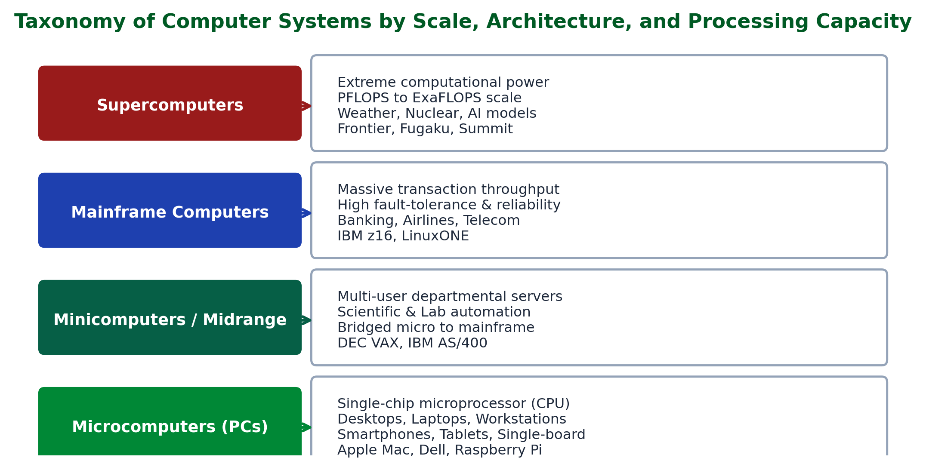
BIT 111: MICROCOMPUTERS AND APPLICATIONS | SOKOINE UNIVERSITY OF AGRICULTURE
Multi-Dimensional Classification of Computer Systems
ARCHITECTURAL ANALYSIS & PRINCIPLES
• Classification by Scale & Power: Supercomputers, Mainframes, Minicomputers, Microcomputers, and Embedded Microcontrollers.
• Classification by Underlying Technology: Analog (continuous voltage), Digital (discrete binary states), and Hybrid (mixed-signal).
• Classification by Purpose: General-Purpose (multipurpose operating systems) vs Dedicated/Special-Purpose (firmware-locked tasks).
• Classification by Network Hierarchy: Enterprise Servers, Workstations, Interactive Clients, and Autonomous Edge Nodes.
Figure: Taxonomy of computer systems classified by Physical Size, Signal Technology, and Operational Purpose.
BIT 111: Microcomputers and Applications | Instructor: Madam Bertha Msuliche Lebalwa (MSc) - SUA Morogoro
Slide 20 of 42

Slide 21
BIT 111: MICROCOMPUTERS AND APPLICATIONS | SOKOINE UNIVERSITY OF AGRICULTURE
Classification by Size: Supercomputers
Extreme Parallelism & High-Performance Computing (HPC)
• Primary Metric: Extreme Floating-Point Operations Per Second (FLOPS). Modern frontier systems exceed 1 ExaFLOPS (10<sup>18</sup> FLOPS).
• Physical Architecture: Hundreds of thousands of multi-core CPU and GPU nodes interconnected by ultra-low-latency networks (e.g., InfiniBand 400 Gbps).
• Thermal & Power Constraints: Consumes 10 to 30 Megawatts of power, requiring liquid immersion or closed-loop water cooling.
• Dominant Applications: Global climate modeling, quantum chemistry simulations, nuclear stockpile stewardship, agricultural genomics, and massive AI training.
• Global Benchmark: The TOP500 list (updated bi-annually using the High-Performance Linpack benchmark).
BIT 111: Microcomputers and Applications | Instructor: Madam Bertha Msuliche Lebalwa (MSc) - SUA Morogoro
Slide 21 of 42

Slide 22
BIT 111: MICROCOMPUTERS AND APPLICATIONS | SOKOINE UNIVERSITY OF AGRICULTURE
Classification by Size: Mainframe Computers
The Bedrock of High-Volume Enterprise Transaction Processing
• Primary Philosophy: Unrivaled Reliability, Availability, and Serviceability (RAS) rather than raw floating-point peak speed.
• Key Attributes: Massive I/O bandwidth, independent specialized channel processors, hardware fault tolerance, and hot-swappable components.
• Operational Uptime: 'Five Nines' (99.999%) availability, equating to less than 5 minutes of unplanned downtime per calendar year.
• Virtualization: Hardware partitioning (LPARs) running thousands of isolated operating system instances simultaneously.
• Enterprise Role: Core banking (CRDB, NMB in Tanzania), national airline reservations, tax revenue processing, credit card clearing.
• Exemplar: IBM z16 running IBM z/OS and Linux on IBM Z.
BIT 111: Microcomputers and Applications | Instructor: Madam Bertha Msuliche Lebalwa (MSc) - SUA Morogoro
Slide 22 of 42

Slide 23
BIT 111: MICROCOMPUTERS AND APPLICATIONS | SOKOINE UNIVERSITY OF AGRICULTURE
Classification by Size: Minicomputers & Microcomputers
Midrange Departmental Systems to Personal Desktop Workstations
• Minicomputers (Midrange Computers):
- Historical role: Bridged the gap between monolithic mainframes and early microcomputers (1960s–1980s).
- Exemplars: DEC PDP-11, VAX-11/780, IBM AS/400 (now IBM i).
- Evolution: Largely superseded today by commodity rack-mounted multi-socket microcomputer servers.
• Microcomputers (Personal Computers):
- Core Definition: Any computer whose central processing unit is a single microprocessor.
- Form Factors: Desktop towers, all-in-one PCs, laptops, convertibles, tablets, smartphones.
- Workstations: High-end microcomputers equipped with multi-core Xeon/Threadripper processors, ECC memory, and workstation GPUs for scientific CAD/GIS.
BIT 111: Microcomputers and Applications | Instructor: Madam Bertha Msuliche Lebalwa (MSc) - SUA Morogoro
Slide 23 of 42

Slide 24
BIT 111: MICROCOMPUTERS AND APPLICATIONS | SOKOINE UNIVERSITY OF AGRICULTURE
Classification: Embedded Computers & Microcontrollers
Invisible Intelligence Powering Modern Machinery and IoT
• Embedded System: A dedicated computer system designed to perform one or a few dedicated functions, often with real-time computing constraints.
• Physical Integration: Microcontroller Unit (MCU) integrating CPU, RAM, ROM/Flash, ADC, and I/O peripherals onto a single microchip.
• Constraints: Low power consumption (milliwatts), compact footprint, harsh environmental tolerance, minimal memory (KB to MB).
• Agricultural Engineering Applications:
- GPS-guided autonomous tractor autosteer units.
- Drip irrigation automated solenoid valve controllers.
- Silo temperature and grain moisture telemetry sensors.
- Exemplars: Arduino (ATmega328P), ESP32 (Wi-Fi/BLE), Raspberry Pi Pico (RP2040), STM32.
BIT 111: Microcomputers and Applications | Instructor: Madam Bertha Msuliche Lebalwa (MSc) - SUA Morogoro
Slide 24 of 42

Slide 25
BIT 111: MICROCOMPUTERS AND APPLICATIONS | SOKOINE UNIVERSITY OF AGRICULTURE
Classification by Technology: Signal Representation
Analog vs Digital vs Hybrid Computing Paradigms
• Analog Computers:
- Process continuous physical variables (voltages, pressures, shaft rotations) without binary quantization.
- Inherently parallel and instantaneous differential equation solvers; limited precision and prone to thermal drift.
• Digital Computers:
- Process discrete binary electrical states (0 and 1, low and high voltage).
- High mathematical precision, perfect reproducibility, arbitrary programmability, and non-volatile storage.
• Hybrid Computers:
- Combine the real-time speed of analog processors with the precision, logic, and storage of digital microcomputers.
- Critical in flight simulators, ICU patient telemetry, and precision agricultural chemical blending systems.
BIT 111: Microcomputers and Applications | Instructor: Madam Bertha Msuliche Lebalwa (MSc) - SUA Morogoro
Slide 25 of 42

Slide 26
BIT 111: MICROCOMPUTERS AND APPLICATIONS | SOKOINE UNIVERSITY OF AGRICULTURE
Classification by Purpose & Network Roles
Operational Scope and Client-Server Distributed Architecture
• Classification by Purpose:
- General-Purpose Computers: Designed to execute a wide variety of software applications (word processing, spreadsheets, games, coding).
- Special-Purpose / Dedicated Computers: Engineered to perform a single invariant task with hardwired or ROM-based logic (ATM controllers, automotive ECUs).
• Classification by Network Hierarchy:
- Client: End-user microcomputer requesting services, data, or web pages across the network.
- Server: High-capacity centralized microcomputer or cluster dedicated to serving resources (Web, File, Database, Mail, DNS).
- Peer-to-Peer (P2P): Decentralized node acting simultaneously as both client and server.
BIT 111: Microcomputers and Applications | Instructor: Madam Bertha Msuliche Lebalwa (MSc) - SUA Morogoro
Slide 26 of 42

Slide 27
BIT 111: MICROCOMPUTERS AND APPLICATIONS | SOKOINE UNIVERSITY OF AGRICULTURE
Factors That Influence Computer Performance
A qualitative introduction for first-year students
• Processor design and the number of tasks it can handle at once influence responsiveness.
• Available memory affects how many programs and data files can be active together.
• Storage type affects how quickly files and applications open.
• Software design and unnecessary background programs can affect the user's experience.
• A single specification does not determine overall performance; consider the intended task and the complete system.
BIT 111: Microcomputers and Applications | Instructor: Madam Bertha Msuliche Lebalwa (MSc) - SUA Morogoro
Slide 27 of 42

Slide 28
BIT 111: MICROCOMPUTERS AND APPLICATIONS | SOKOINE UNIVERSITY OF AGRICULTURE
Choosing a Computer for Its Intended Work
Comparing needs across SUA disciplines
• Agricultural researchers may prioritize reliable data handling and compatibility with field equipment.
• Veterinary and animal-science teams may need dependable access to records, images, and office applications.
• Tourism and extension staff may prioritize portability, connectivity, and battery life.
• Engineering, aquaculture, forestry, and food-science teams should match the device to their specialist software and data.
• Compare whole-system needs rather than relying on one advertised specification.
BIT 111: Microcomputers and Applications | Instructor: Madam Bertha Msuliche Lebalwa (MSc) - SUA Morogoro
Slide 28 of 42

Slide 29
BIT 111: MICROCOMPUTERS AND APPLICATIONS | SOKOINE UNIVERSITY OF AGRICULTURE
Computer Selection Case Study
A conceptual example from agricultural research
• A research team collects crop images in the field and reviews them at the university.
• Field staff need portable devices that can capture and safely transfer image files.
• Researchers reviewing large image collections may need a desktop with suitable memory and graphics capability.
• The team should also consider software compatibility, backup, maintenance, and cost.
• Explain which factors matter most for each role; no performance calculations are required.
BIT 111: Microcomputers and Applications | Instructor: Madam Bertha Msuliche Lebalwa (MSc) - SUA Morogoro
Slide 29 of 42

Slide 30
BIT 111: MICROCOMPUTERS AND APPLICATIONS | SOKOINE UNIVERSITY OF AGRICULTURE
Microcomputer Applications in Smart Agriculture
Field Case Studies from Sokoine University of Agriculture
• SUA Mazimbu & Solomon Mahlangu Experimental Farms:
- Drip Irrigation Automation: Microcontrollers monitor soil conditions and control water solenoids.
- Drone Photogrammetry: Rugged microcomputer workstations process multispectral aerial imagery into NDVI crop stress maps.
- Dairy Cattle Telemetry: RFID transponders read cow collars at automated feeding stations, logging milk yield into central MySQL databases.
- Weather Telemetry Nodes: Solar-powered single-board computers transmit temperature, humidity, and rainfall data over cellular networks to DIIT servers.
• Agricultural Extension Dispatches: Tablet microcomputers utilized by extension agents to identify pest infestations via computer vision models.
BIT 111: Microcomputers and Applications | Instructor: Madam Bertha Msuliche Lebalwa (MSc) - SUA Morogoro
Slide 30 of 42

Slide 31
BIT 111: MICROCOMPUTERS AND APPLICATIONS | SOKOINE UNIVERSITY OF AGRICULTURE
Hardware Diagnostics via Linux Terminal
Inspecting System Architecture & Microcomputer Peripherals
• Essential Hardware Inspection Commands in Ubuntu Linux:
- `lscpu`: Displays comprehensive CPU architecture, cores, threads, sockets, virtualization, and cache sizes (L1d, L1i, L2, L3).
- `free -h`: Displays total, used, free, and available system RAM in human-readable mebibytes/gibibytes.
- `lsblk`: Displays block storage devices, partitions, mount points, and drive types (NVMe vs SATA).
- `lspci`: Lists all PCI/PCIe peripheral buses and connected controllers (GPU, Ethernet, NVMe).
- `lsusb`: Enumerates all Universal Serial Bus devices, hubs, and agricultural serial interfaces.
- `dmidecode -t bios`: Queries motherboard SMBIOS tables for firmware vendor, version, and release date.
BIT 111: Microcomputers and Applications | Instructor: Madam Bertha Msuliche Lebalwa (MSc) - SUA Morogoro
Slide 31 of 42

Slide 32
BIT 111: MICROCOMPUTERS AND APPLICATIONS | SOKOINE UNIVERSITY OF AGRICULTURE
Topic 1: Key Takeaways & Synthesis Matrix
Summary of Core Concepts for Examination Mastery
• Five Generations: Defined by active electronics (Tubes → Transistors → ICs → VLSI Microprocessors → ULSI/AI/Quantum).
• Von Neumann Model: Unified memory for data and instructions; performance constrained by the Von Neumann Bottleneck.
• Pioneers: Babbage (hardware architecture), Lovelace (software algorithm), Turing (computability), von Neumann (stored program), Noyce/Kilby (IC), Hoff (microprocessor).
• Classifications: Scale (Super > Mainframe > Mini > Micro > Embedded), Signal (Digital vs Analog vs Hybrid), Role (Client vs Server).
• Performance depends on the processor, memory, storage, software, and the task being performed.
BIT 111: Microcomputers and Applications | Instructor: Madam Bertha Msuliche Lebalwa (MSc) - SUA Morogoro
Slide 32 of 42

Slide 33
BIT 111: MICROCOMPUTERS AND APPLICATIONS | SOKOINE UNIVERSITY OF AGRICULTURE
Review Quiz & Knowledge Check
Self-Testing Key Technical Concepts
1. Why is the stored-program concept considered the most revolutionary breakthrough in computer design history?
2. Contrast the physical reasons why magnetic ferrite core memory displaced vacuum delay lines in 2nd generation computers.
3. Name two system characteristics that can affect how responsive a computer feels, and explain why one specification alone is not enough.
4. Why can a program fail to benefit from a computer with multiple processor cores?
5. What computer classification is optimal for an automated solar-powered irrigation valve controller in Kilosa?
BIT 111: Microcomputers and Applications | Instructor: Madam Bertha Msuliche Lebalwa (MSc) - SUA Morogoro
Slide 33 of 42

Slide 34
BIT 111: MICROCOMPUTERS AND APPLICATIONS | SOKOINE UNIVERSITY OF AGRICULTURE
Reading Assignments & Homework Notice
Preparation for Next Lecture & Continuous Assessment
• Required Readings:
- Smith, J. L., Wang, S., & Mortati, J. - Information Systems for Business and Beyond (2019), Chapter 1. https://opentextbook.site/informationsystems2019/
- Vermaat et al. - Discovering Computers: Digital Technology, Data, and Devices (16th ed.). Cengage. https://faculty.cengage.com/works/9781337285100
• Homework Assignment 1 Notice:
- Available on SUA Moodle / Assignment directory: `BIT_111_Assignment_1.pdf`.
- Total Allocation: 100 Marks (Covers computer concepts and applied design).
- Submission Deadline: End of Week 2 by 17:00 EAT.
• Next Lecture Preview: Topic 2 — Main Components of a Microcomputer (CPU, Buses, Memory, I/O).
BIT 111: Microcomputers and Applications | Instructor: Madam Bertha Msuliche Lebalwa (MSc) - SUA Morogoro
Slide 34 of 42

Slide 35
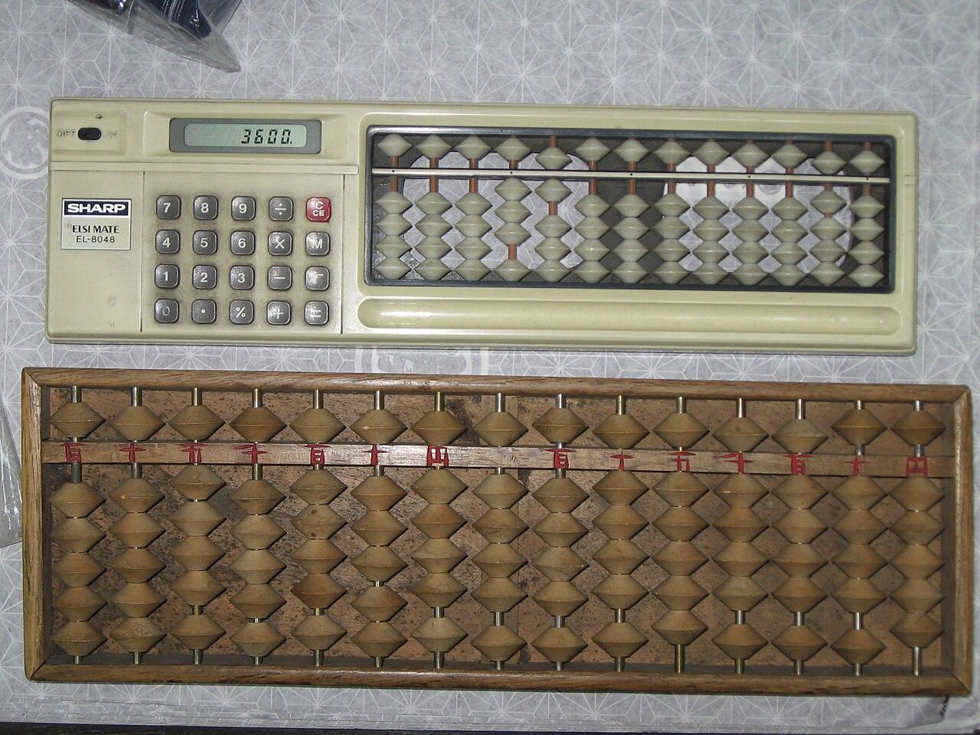
BIT 111: MICROCOMPUTERS AND APPLICATIONS | SOKOINE UNIVERSITY OF AGRICULTURE
Topic 1: Abacus actually in use at kimono shop in Otaru.jpg
IMAGE NOTES
Description: Abacus actually in use at kimono shop in Otaru
Creator: Syced
License: CC0
Source: Wikimedia Commons file page
License details
BIT 111: Microcomputers and Applications | Instructor: Madam Bertha Msuliche Lebalwa (MSc) - SUA Morogoro
Slide 35 of 42

Slide 36
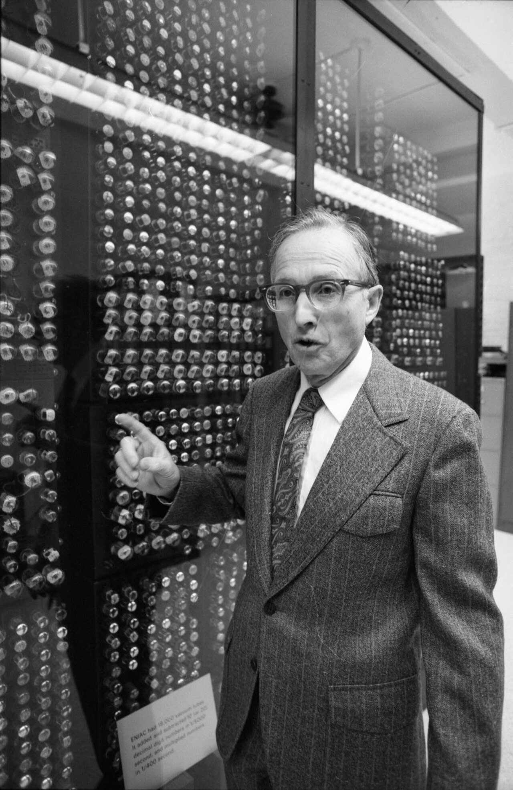
BIT 111: MICROCOMPUTERS AND APPLICATIONS | SOKOINE UNIVERSITY OF AGRICULTURE
Topic 1: Arthur Burks, with a section of the ENIAC computer.jpg
IMAGE NOTES
Description: Arthur Burks, with a section of the ENIAC computer
Creator: University of Michigan. News and Information Services.
License: CC BY 4.0
Source: Wikimedia Commons file page
License details
BIT 111: Microcomputers and Applications | Instructor: Madam Bertha Msuliche Lebalwa (MSc) - SUA Morogoro
Slide 36 of 42

Slide 37
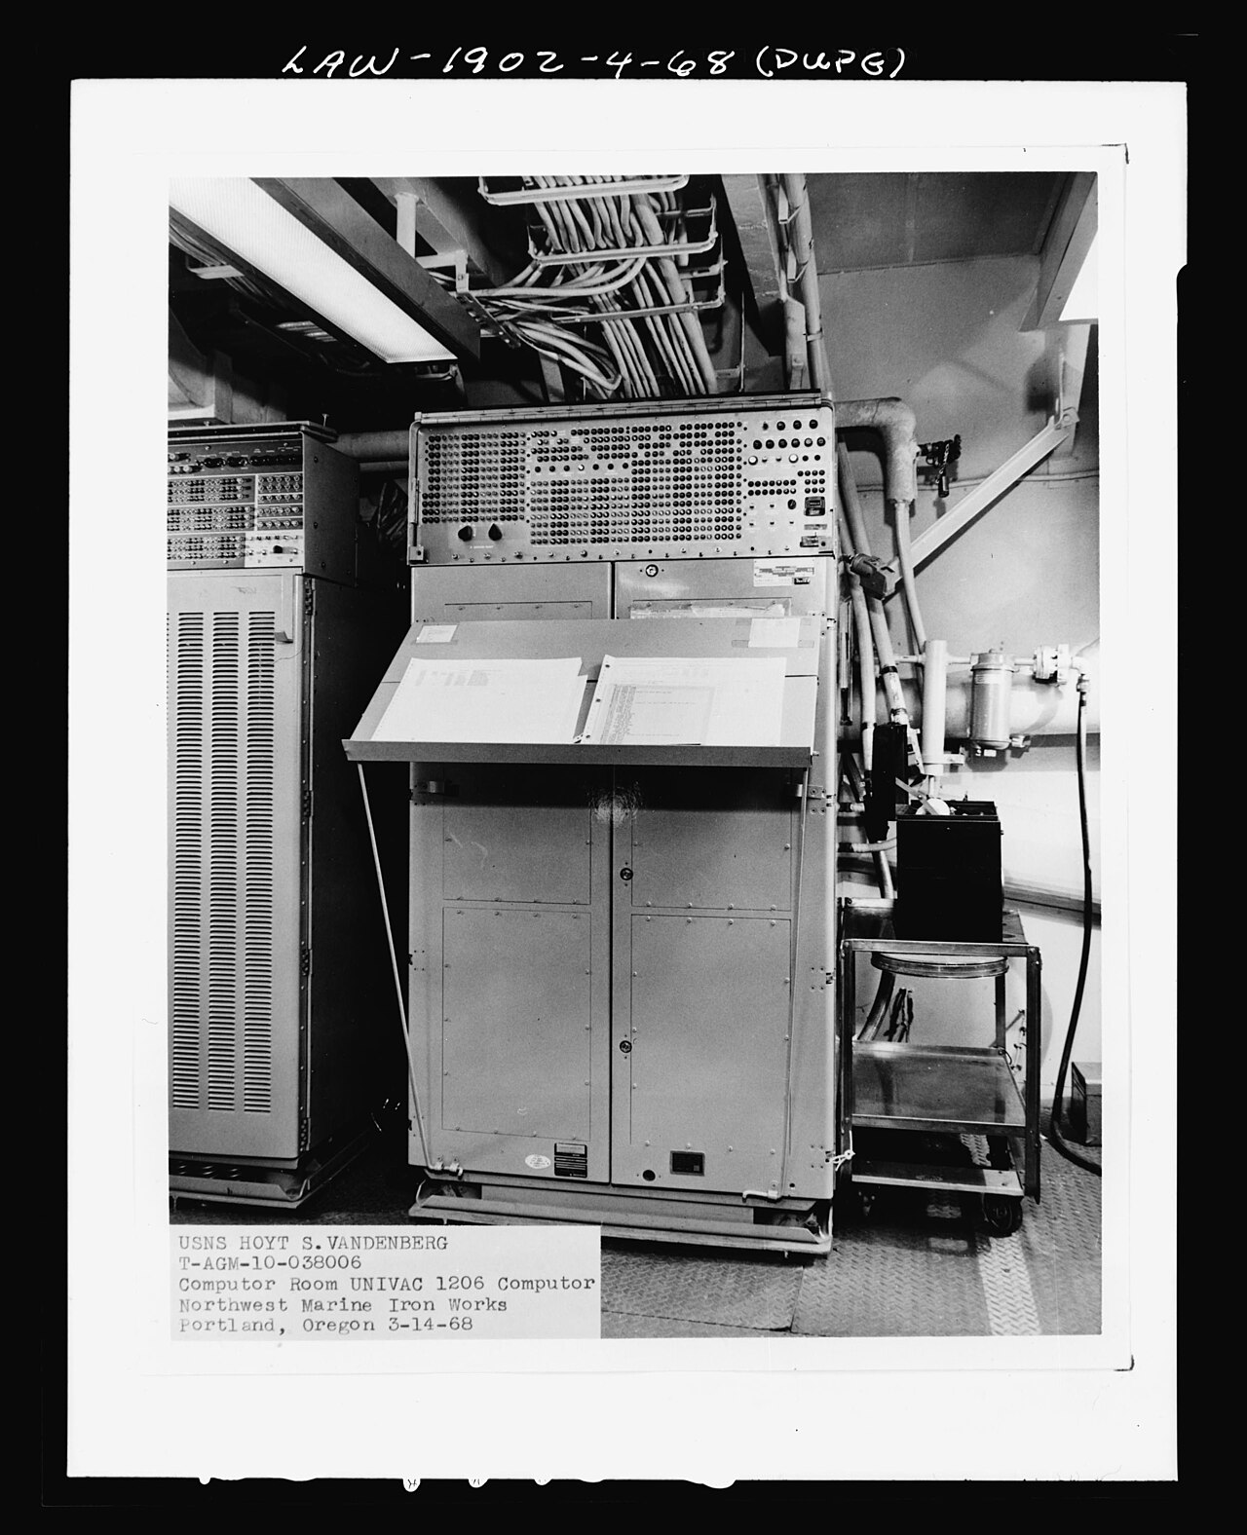
BIT 111: MICROCOMPUTERS AND APPLICATIONS | SOKOINE UNIVERSITY OF AGRICULTURE
Topic 1: 19-NN-AGM-10 General Vadenburg-NAID6929976.jpg
IMAGE NOTES
Description: 19-NN-AGM-10 General Vadenburg-NAID6929976
Creator: Department of Defense. Department of the Navy. Bureau of Ships.
License: Public domain
Source: Wikimedia Commons file page
BIT 111: Microcomputers and Applications | Instructor: Madam Bertha Msuliche Lebalwa (MSc) - SUA Morogoro
Slide 37 of 42

Slide 38
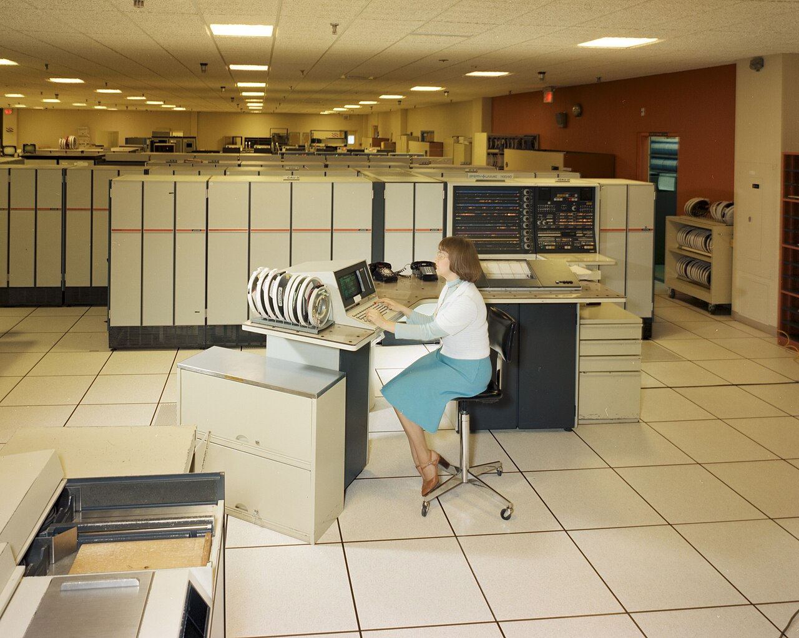
BIT 111: MICROCOMPUTERS AND APPLICATIONS | SOKOINE UNIVERSITY OF AGRICULTURE
Topic 1: 255-GRC-1983-C-01769.jpg
IMAGE NOTES
Description: 255-GRC-1983-C-01769
Creator: Unknown author
License: Public domain
Source: Wikimedia Commons file page
BIT 111: Microcomputers and Applications | Instructor: Madam Bertha Msuliche Lebalwa (MSc) - SUA Morogoro
Slide 38 of 42

Slide 39
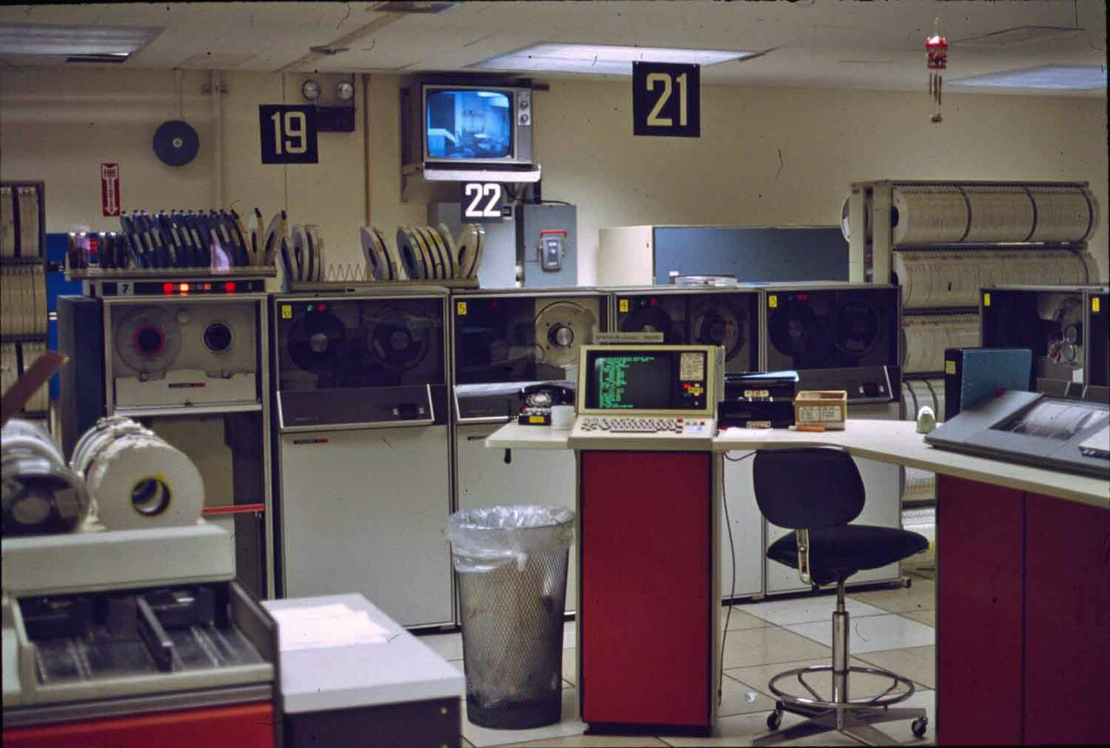
BIT 111: MICROCOMPUTERS AND APPLICATIONS | SOKOINE UNIVERSITY OF AGRICULTURE
Topic 1: AlbanyStateUniversity ComputerOperationsRoom 1981 3 skaliert.jpg
IMAGE NOTES
Description: AlbanyStateUniversity ComputerOperationsRoom 1981 3 skaliert
Creator: Erick M. Griffin
License: Public domain
Source: Wikimedia Commons file page
BIT 111: Microcomputers and Applications | Instructor: Madam Bertha Msuliche Lebalwa (MSc) - SUA Morogoro
Slide 39 of 42

Slide 40
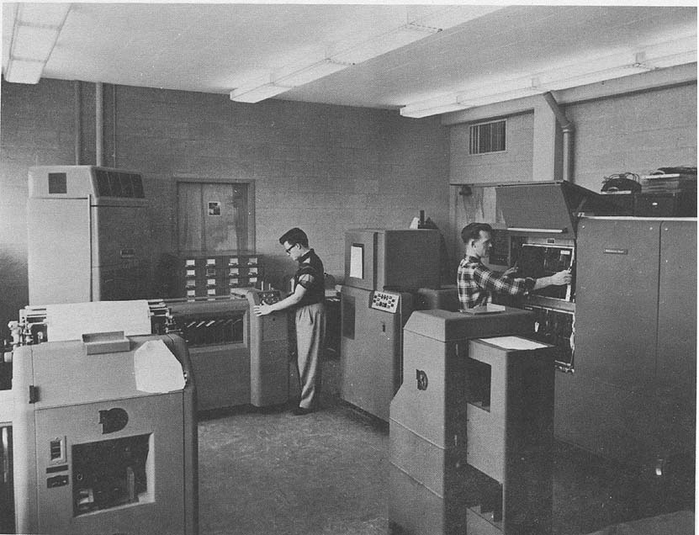
BIT 111: MICROCOMPUTERS AND APPLICATIONS | SOKOINE UNIVERSITY OF AGRICULTURE
Topic 1: BRL61-0892.jpg
IMAGE NOTES
Description: BRL61-0892
Creator: U. S. Army Chemical Corps Proving Ground (Dugway)
License: Public domain
Source: Wikimedia Commons file page
BIT 111: Microcomputers and Applications | Instructor: Madam Bertha Msuliche Lebalwa (MSc) - SUA Morogoro
Slide 40 of 42

Slide 41
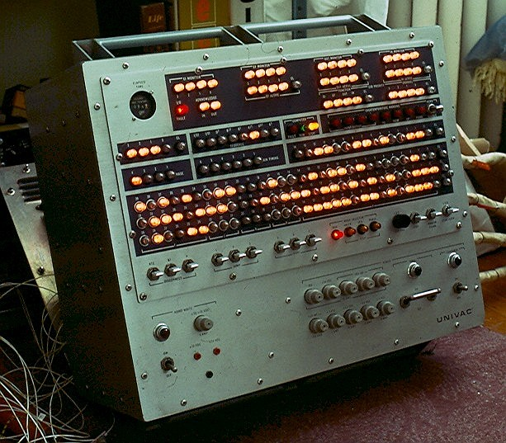
BIT 111: MICROCOMPUTERS AND APPLICATIONS | SOKOINE UNIVERSITY OF AGRICULTURE
Topic 1: Control Console of Univac 1830 Computer.jpg
IMAGE NOTES
Description: Control Console of Univac 1830 Computer
Creator: LaserSam
License: CC BY-SA 4.0
Source: Wikimedia Commons file page
License details
BIT 111: Microcomputers and Applications | Instructor: Madam Bertha Msuliche Lebalwa (MSc) - SUA Morogoro
Slide 41 of 42

Slide 42
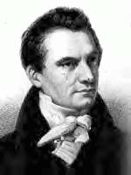
BIT 111: MICROCOMPUTERS AND APPLICATIONS | SOKOINE UNIVERSITY OF AGRICULTURE
Topic 1: Charles-babbage.jpg
IMAGE NOTES
Description: Charles-babbage
Creator: Enslin (original uploader, German Wikipedia)
License: Public domain
Source: Wikimedia Commons file page
BIT 111: Microcomputers and Applications | Instructor: Madam Bertha Msuliche Lebalwa (MSc) - SUA Morogoro
Slide 42 of 42

